Slide 1
History of Social Welfare Development in the UK
(Pre-1601 era)
By:
Prof. Amir Zada Asad
Dr. Imran A. Sajid
Source: Walter Friedlander. Introduction to Social Work and Social Welfare.
Notes:
Brenda Dubois and Karla Miley. (1995). Social Work: An Empowering Profession

Slide 2
Medieval Europe
The present day Europe was not so advanced during medieval era, rather the countries and states faced with the worst type of Socio-economic problems, so big that the states could not solve these problems for centuries.
Renaissance 14th, 15^{th,} 16th Century Europe.
Greek and their own age is advanced and civilized
medieval →
medium (middle)
aevum (age)
Early Middle Ages: 350 to 1050;
High Middle Ages:1050 to 1300;
Late Middle Ages: 300 to about 1450
AD 350 to 1450 in Europe
Notes:
Microsoft ® Encarta ® 2009. © 1993-2008 Microsoft Corporation. All rights reserved.

Slide 3
The problems were enormous and gigantic.
These problems included poverty, famine, unemployment, wars, feudalism, sickness, diseases, helplessness, illiteracy, ignorance etc.
Beggary was the biggest social problem.

Slide 4

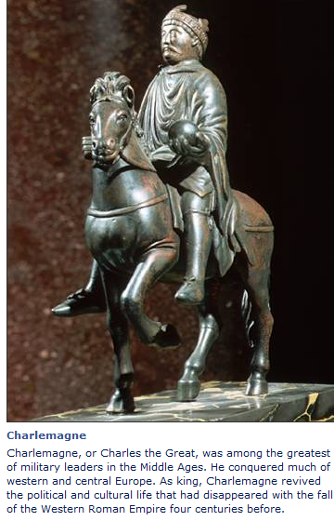
The Role of Church and the Rise of beggary
We know that the concept and practice of mutual help and help to the needy was primarily religion based.
During medieval era, when Christianity was declared as state religion by Charlemagne in 800 AD, in Germany the church assumed the responsibility of helping the needy.
The Church and the Bishop were more important than any thing else.

Slide 5
Institutions for the poor and needy were established in the monasteries, serving as orphanages, homes for the aged and sick, disabled, women, children, refuge for the homeless.

Slide 6
These institutions for the poor were financed by income through beggary and alms from the upper class people.
The situation not only encouraged beggary but also gave it a respectable status in the society.
Under these conditions beggary grew exponentially throughout Europe as asking for alms was not only an easy way of living a life but also respectable as the alms income was shared with the missionaries and monks, as well as spent on Crusaders returning from or on their way to the holy wars.

Slide 7
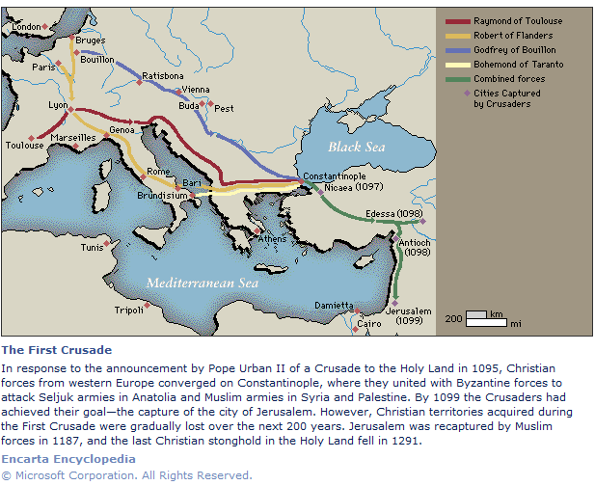

Slide 8
As a result of this situation, beggary became a serious social problem throughout Europe.
Bands of able-bodied beggars and vagrants* traveled from place to place and robbed and looted and even put on arson villages and dwellings where alms were refused to them.
*homeless

Slide 9
This situation became intolerable and became a dreadful event for many isolated villages.
Even today, if mothers frighten their children by the lullaby-( to lull a child to sleep)
Hark hark, the dogs bark, the beggars come to the town

Slide 10
The older church institutions, in which charity was rendered—monasteries, abbeys, convents—were partly replaced by the hospitals which administered the old, sick, orphans, pregnant women, abandoned children etc.
They became the main agencies of medieval charity.
Convent: a community of women who live a life devoted largely to religious worship

Slide 11
However, few of the needy found a place in these institutions and many wandering beggars remained on roads and were a curse with which state as well as the local governments was unable to cope.

Slide 12
The Conflicts
Two conflicts arose at that time viz
  the difference of opinion regarding charities and alms giving
  the misuse of alms by the church authorities
This led to a severe criticism, demand for control measures, and the setting up of boards of supervision by the state.

Slide 13
In order to stop vagrancy and mendicancy, many European countries enacted laws prescribing severe penalties, but none succeeded in wiping out the menace of vagrancy, because this was a “religious mendicancy”.

Slide 14
During 16th century this conflict became more violent.
Martin Luther in 1520, in Germany appealed the Christian nobility of the German nation to ban beggary and to arrange a ‘common chest’ to collect money, food and clothes for distribution among the needy and destitute.

Slide 15
He appealed that regular donations be made in addition to the voluntary contribution to these chests.
In a sense this was the recognition of the community responsibility to support and maintain its own poor.
This did little to change the social conditions of destitute families

Slide 16
Welfare Legislation during 14th-16th century
1349—the first poor law
1531—licensing beggars in specified areas
1536—confiscation of all the church properties and resulting laws
1562—Statute of Artificers
1563—Weekly Tax
1572—the parliament imposing a tax
1576—House of Correction
1597—provided for the appointment of church wardens

Slide 17
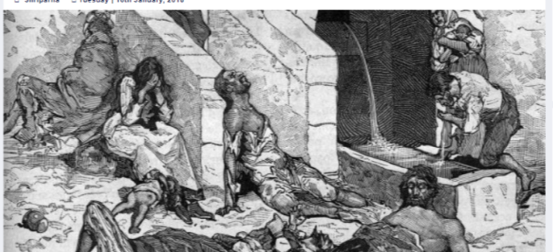
THE FIRST WELFARE ENACTMENT IN ENGLAND
1349, STATUTE OF LABOUR
The first poor law in England was based on a national catastrophe.
In 1348 plague or ‘Black Death’ was caused by infected rats brought from Levant Greece, on a ship.
This plague killed two third of the entire English population within two years.

Slide 18
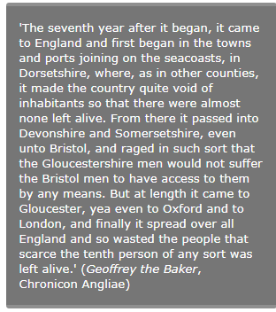
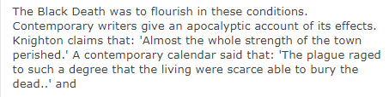
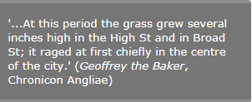
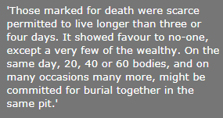
`

Slide 19
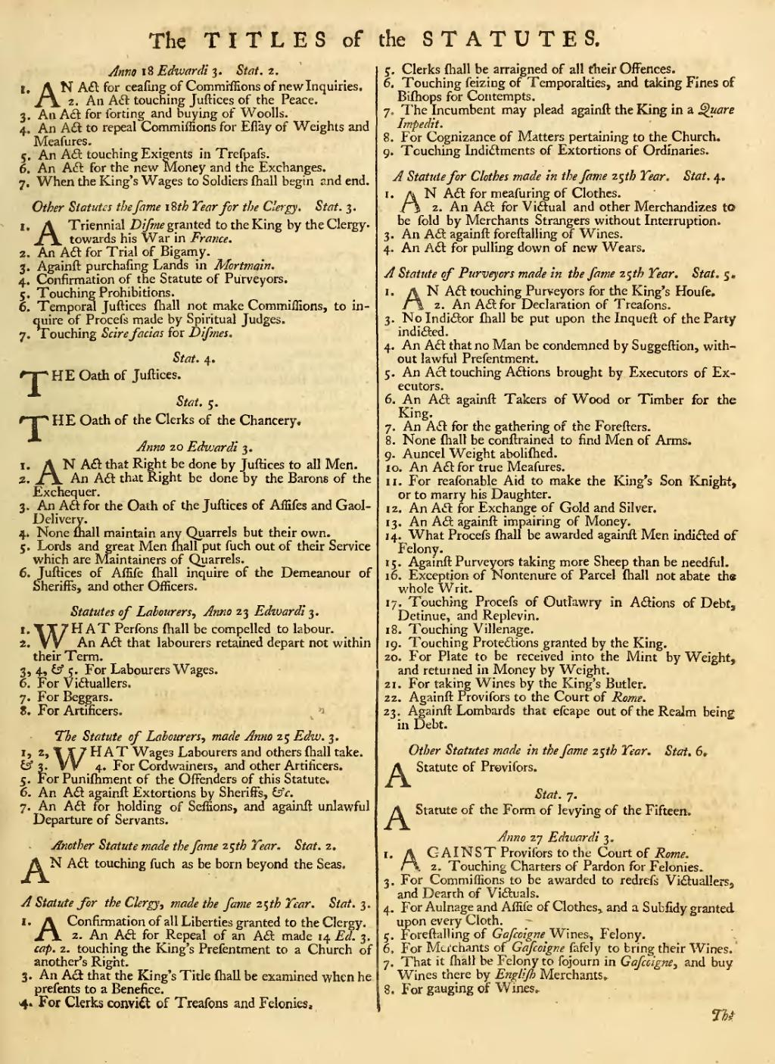
This situation resulted in extreme shortage of laborers for agriculture purpose.
As a result of the shortage of laborers the wages also shot-up which was resisted by the landed class.
On the insistence of the landed aristocracy, King Edward –III issued the first statute called the
“Statute of Labourers of 1349”.

Slide 20
Statute of Labourers, 1349
It ordered that ;
  Able-bodied laborers without means must accept employment from any master willing to hire them and
  forbade them to leave their parish.
  Citizens were not allowed to give alms to able-bodied beggars.”

Slide 21
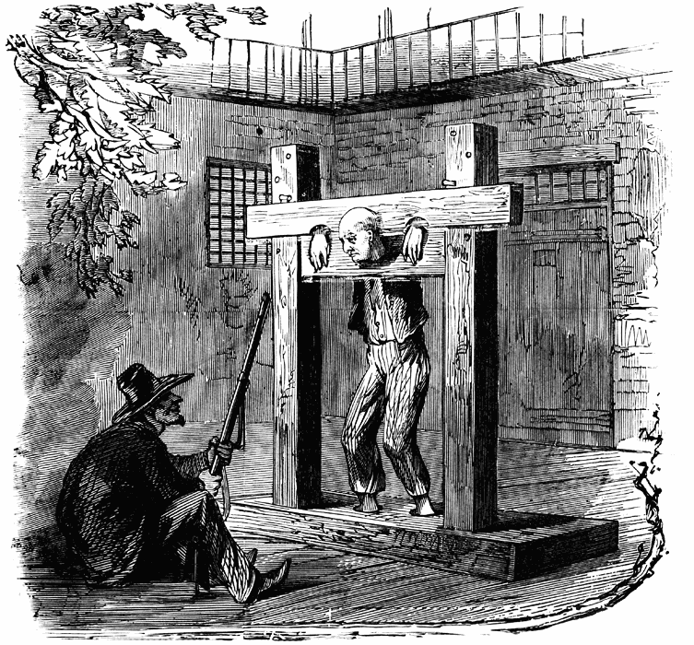
Very cruel punishment such as being
  put into the stock,
  whipping,
  mutilating by cutting the nose and ears,
  branding, and
  finally hanging the able-bodied beggars
was ordered.

Slide 22
Statute of Labourers, 1349
This law was designed to prevent vagrancy and beggary and to force the rural laborers to stay on the lands and was the first to replace the clerical orders by secular trends, from church to the state.

Slide 23
1531- Punishment of Beggars and Vagabonds Statute| licensing beggars in specified areas
During 15th century another economic change happened in England.
During this period the woolen industry came into being. It was more profitable than agriculture.
Agricultural lands were converted into pasture lands and big herds of sheep were kept by the land owners.
For keeping herds of sheep very few workers were needed as compared to tilling the lands.

Slide 24
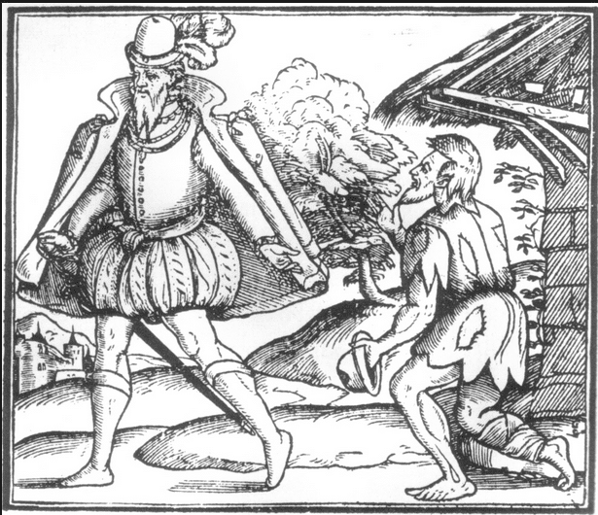
This gave birth to another wave of unemployment and poverty.
Consequently, many agricultural laborers resolved to beggary.
The aged, the sick, and the disabled were suffering to the maximum.
Many people applied for help to the parish.

Slide 25
Keeping in view this situation, some reforms were introduced by King Henry –VIII in 1531.
  It was ordered that Mayors and Justice of Peace will investigate application of the impotent beggars who were maintained by parish.
  Such beggars were registered and licensed to beg in an assigned area.
This law was the beginning of the recognition of the public responsibility for the poor.
Whipping was instigated instead of just putting in stocks.

Slide 26
1536: Act for Punishment of Sturdy Vagabonds and Beggars 1536| confiscation of all the church properties and resulting laws
The conflict between Henry VIII and the Roman Catholic Church eventually led to the seizure of Church properties by the state. Over 800 monasteries were dissolved, demolished for building materials, sold off or reclaimed as Anglican Churches.
With this, the source of support to many vanished.
As a result of the confiscation of church property, it became necessary to provide otherwise for the relief of the poor.
Notes:
The guilds and other organizations of support had already vanished during 15th century.

Slide 27
Consequently, the government of England in 1536, Under the Statute of 1536, established the first plan of public relief. It ordered that ‘
“Paupers could be registered in their parishes only after they had resided in the county for three years. The parish had to maintain the impotent poor from the voluntary funds of the parishioners through church collection.”

Slide 28
The 1536 act provided
  that “sturdy*” vagabonds should be set to work after being punished.
  It also provided that local mayors, bailiffs, constables, and other officers were responsible for ensuring that the poor in their parish were cared for such that they need not beg.
    Although they could not use municipal funds nor levy a compulsory tax on the parish to raise this money, they organized collections in a common box.
    In addition, voluntary contributions to the poor other than through the common box were made illegal; the goal of this latter provision was to control discriminatory giving.
*well made

Slide 29
Able bodied beggars were forced to work.
Idle children of age 5-14 were taken away from their parents and were indentured.
  Boys of age 5-14 were indentured with craftsmen in the towns to learn some technical jobs and
  Girls with wealthy people to keep them as maid-servants up till the age of 21 years.

Slide 30
Although this act lapsed later in 1536, its designation of the parish as the administrator of charitable giving lasted into future poor law reforms.

Slide 31
1562
  1563
    1572
      1576
        1597

Slide 32
1562, Statute of Artificers*
In 1562, another law was passed known as the “Statute of Artificers”.
Under this law the wages and working hours were regulated and a system of apprenticeship introduced.
Able-bodied unemployed poor and beggars between the age of 12-60 years could be hired as servants.
*skilled worker

Slide 33
Due to confiscation of church properties, the role of church was minimized.
Many families and individual who were dependent on the church, were left unprotected.
Many thousands of monks, priests and nuns who were formerly employed by churches became unemployed and the ranks of poor swelled.

Slide 34
1563, Weekly Tax
As a result work became scarce and the prices of food rose, poverty increased and thus beggary increased.
In order to finance the parish poor, the parliament had to impose a compulsory measure of Weekly Contribution by the parishioner based on income and property in 1563.

Slide 35
1572, the parliament imposing a General Tax
In 1572, Queen Elizabeth signed a Statute of the parliament imposing a General Tax to
  provide fund for the poor relief and
  appointed overseers for the administration of the new law.
This law finally recognized the government responsibility for providing aid to the poor who could not maintained themselves.

Slide 36
1576, House of Correction
In 1576, the government established the “houses of Correction” which came to be known as “Work Houses” later.
These ‘houses of correction’ were supplied with
  wool,
  iron,
  hemp,
  flex,
  where able bodied poor and unemployed and particularly the young were forced to work.
It was a kind of ‘food for work’ and ‘accommodation for work’ program. Here people living in poverty were given food and accommodations in return for unpaid work

Slide 37
1597, Church Wardens, Alms Houses
In 1597, another statute was passed which provided for the appointment of Church Wardens and four parishioners / householders to oversee the poor law system in the locality.
Alms houses were established for the help of impotent poor like aged, blind, disabled etc who could not work.
This law made responsible parents/ children for the maintenance of each other.

